Slide 1
Generating Natural-Language Video Descriptions Using LSTM Recurrent Neural Networks
Or: How I Learned to Stop Worrying and Love Deep Learning
Ray Mooney
Department of Computer Science
University of Texas at Austin
Joint work with
Subhashini Venugopolan
Kate Saenko Trevor Darrell Marcus Rohrbach Huijuan Xu Jeff Donahue Lisa A. Hendricks

Slide 2

Explanation of Subtitle

Slide 3
Grounding Language in Perception
Most work in natural language processing deals only with text and represents the meaning of words and sentences in terms of other words or textual symbols.
Truly understanding the meaning of language requires grounding semantics in perception and action in the world.
Search “grounded language learning” on videolectures.net to find my AAAI-13 keynote

Slide 4
Integrating Language and Vision
In particular, integrating natural language processing and computer vision is an important aspect of language grounding.
A number of recent workshops on the topic:
NIPS-2011 Workshop on Integrating Language and Vision
NAACL-2013 Workshop on Vision and Language
CVPR-2013 Workshop on Language for Vision
COLING-2014 Workshop on Vision and Language
CVPR-2015 Workshop on Language and Vision

Slide 5
Generating Descriptions of Images
Kuznetsova, et al., ACL-2012
Kulkarni, et al., CVPR-2011
Farhadi, et al., ECCV-2010
8 papers at CVPR-2015 resulting in news articles in NYTimes and PC World

Slide 6
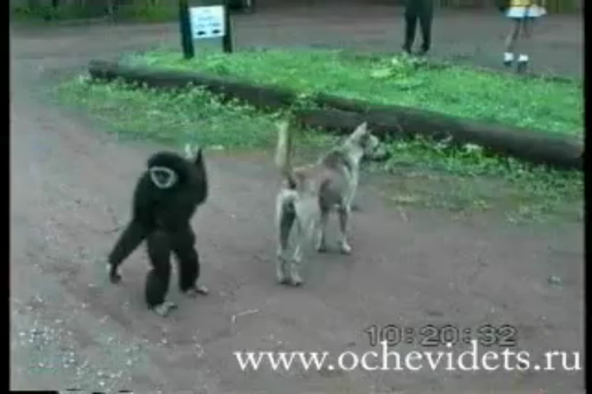
Generating Descriptions of Videos
A monkey pulls a dog’s tail and runs away.

Slide 7
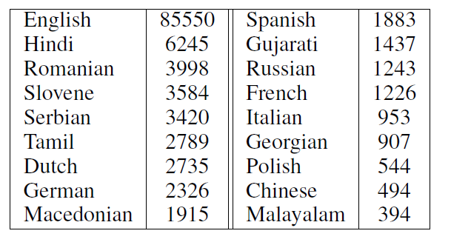
Video Description Dataset (Chen & Dolan, ACL 2011)
2,089 YouTube videos with 122K multi-lingual descriptions.
Originally collected for paraphrase and machine translation examples.
Available at: http://www.cs.utexas.edu/users/ml/clamp/videoDescription/

Slide 8
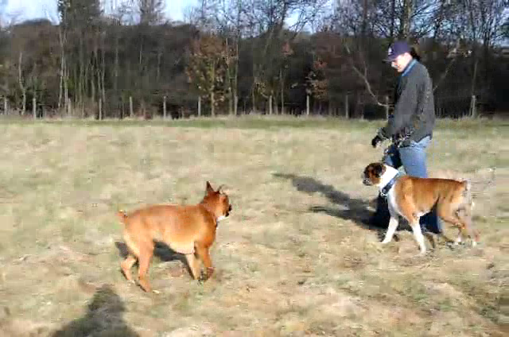
Sample Video

Slide 9
Sample M-Turk Human Descriptions (average ~50 per video)
A MAN PLAYING WITH TWO DOGS
A man takes a walk in a field with his dogs.
A man training the dogs in a big field.
A person is walking his dogs.
A woman is walking her dogs.
A woman is walking with dogs in a field.
A woman is walking with four dogs outside.
A woman walks across a field with several dogs.
All dogs are going along with the woman.
dogs are playing
Dogs follow a man.
Several dogs follow a person.
some dog playing each other
Someone walking in a field with dogs.
very cute dogs
A MAN IS GOING WITH A DOG.
four dogs are walking with woman in field
the man and dogs walking the forest
Dogs are Walking with a Man.
The woman is walking her dogs.
A person is walking some dogs.
A man walks with his dogs in the field.
A man is walking dogs.
a dogs are running
A guy is training his dogs
A man is walking with dogs.
a men and some dog are running
A men walking with dogs.
A person is walking with dogs.
A woman is walking her dogs.
Somebody walking with his/her pets.
the man is playing with the dogs.
A guy training his dogs.
A lady is roaming in the field with his dogs.
A lady playing with her dogs.
A man and 4 dogs are walking through a field.
A man in a field playing with dogs.
A man is playing with dogs.

Slide 10
Deep Neural Nets
Recent success on Deep Convolutional Neural Nets (CNNs) for vision (Krishevsky, et al., 2012).
Even more recent results on Long Short Term Memory (LSTM) deep recurrent neural nets (RNNs) for machine translation (Sutskever et al., 2014).
Very recent results on combining CNNs and LSTMs for image description (Donahue et al., 2015; Vinyals et al., 2015).

Slide 11
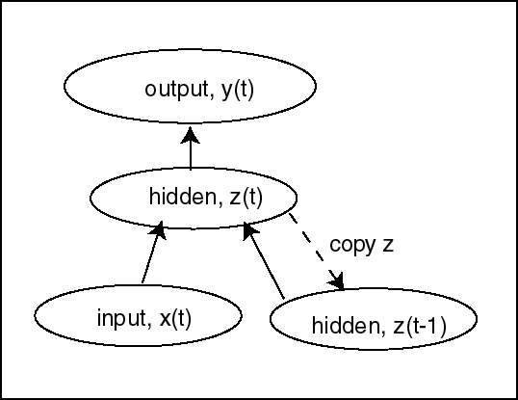
Background - RNN
Recurrent neural nets can be used to map an input sequence x to an output sequence y.
Due to vanishing/exploding gradient problem, it is diffcult to train a network to maintain memory for many cycles.
Long Short-Term Memory (LSTM) explicitly controls memory (Hochreiter & Schmidhuber, 1997).

Slide 12
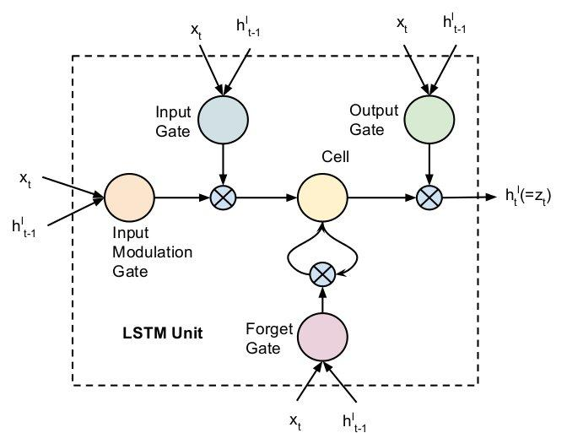
Background - LSTM Unit
Recurrent unit controlled by 3 sigmoidal [0,1] gates
Input: input is significant to remember
Forget: whether or not to forget previous hidden state
Output: whether or not to output a value
Can potentially “remember” value for many time steps

Slide 13
LSTM Sequence decoders
Two LSTM layers - 2nd layer of depth in temporal processing.
Softmax over the vocabulary to predict the output at each time step.
LSTM
LSTM
SoftMax
out t0
t=0
input
LSTM
LSTM
SoftMax
out t1
t=1
input
LSTM
LSTM
SoftMax
out t2
t=2
input
time
LSTM
LSTM
SoftMax
out t3
t=3
input
Notes:
In our model we use two such stacks. The network is trained using Stochastic Gradient Descent. Errors are backpropagated.

Slide 14


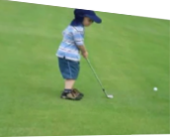
Recurrent Neural Networks (RNNs)
Encoder/Decoder Sequence to Sequence
English
Sentence
RNN encoder
RNN decoder
French
Sentence
[Sutskever et al. NIPS’14]
Encode
RNN decoder
Sentence
[Donahue et al. CVPR’15]
[Vinyals et al. CVPR’15]
Encode
RNN decoder
Sentence
[Venugopolan et al. NAACL’15]
Encode
RNN encoder
RNN decoder
Sentence
[Venugopalan et al. ICCV’15] (this work)
Notes:
We go back to the original machine translation framework. Encode french sentences to vector and decode to english sentence.
Video is a sequence of frames

Slide 15




S2VT: Sequence to Sequence Video to Text
CNN
CNN
CNN
CNN
Now decode it to a sentence!
LSTM
LSTM
LSTM
LSTM
LSTM
LSTM
LSTM
LSTM
...
LSTM
LSTM
LSTM
LSTM
LSTM
LSTM
LSTM
LSTM
Encoding stage
A
man
is
talking
...
Decoding stage
Notes:
Our model uses LSTMs to encode the video clip frame by frame and then decodes it word by word to generate an english description.

Slide 16
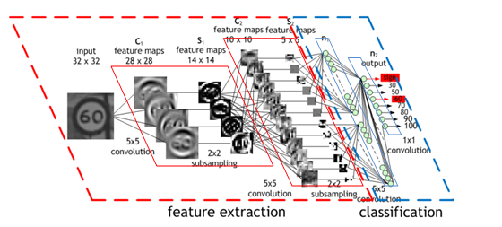

Convolutional Neural Networks (CNNs)
Successful in semantic visual recognition tasks.
Layers of linear filters followed by a multi-layer non-linear classifier.
Learns a hierarchy of features of increasing semantic richness.
Image Credit: Maurice Peeman
Krizhevsky, Sutskever, Hinton 2012
ImageNet classification breakthrough
Notes:
Recently they have re-emerged as a powerful feature learning technique.

Slide 17
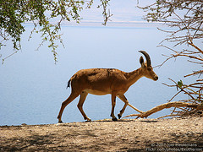

1. Train on Imagenet
1000 categories
[Simonyan & Zisserman ICLR’15]
(VGG-16)
CNN
2. Take activations from layer before classification
fc7: 4096 dimension “feature vector”
CNN
Forward propagate
Output: “fc7” features
(activations before classification layer)
Frames: RGB

Slide 18
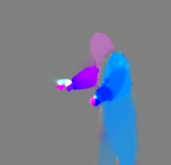




UCF 101
1. Train CNN on
Activity classes
101 Action Classes
[Donahue et al. CVPR’15]
CNN
(modified AlexNet)
2. Use optical flow to extract flow images.
[T. Brox et. al. ECCV ‘04]
3. Take activations from layer before classification
fc7: 4096 dimension “feature vector”
Explicit Activity Recognition Features
CNN
Frames: Flow
Forward propagate
Output: “fc7” features
(activations before classification layer)

Slide 19



CNN
CNN
CNN
CNN
Now decode it to a sentence!
LSTM
LSTM
LSTM
LSTM
LSTM
LSTM
LSTM
LSTM
...
LSTM
LSTM
LSTM
LSTM
LSTM
LSTM
LSTM
LSTM
Encoding stage
A
man
is
talking
...
Decoding stage
[Venugopalan et. al. ICCV’15]
Notes:
Our model uses LSTMs to encode the video clip frame by frame and then decodes it word by word to generate an english description.

Slide 20
Evaluation Methodology
Machine Translation Metrics: Measure similarity of generated sentence to “gold standard” human descriptions.
BLEU
METEOR
Human Evaluation: Ask crowd-sourced human judges to evaluate relevance and grammaticality of generated descriptions.

Slide 21
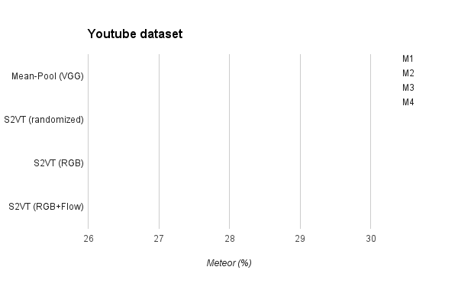
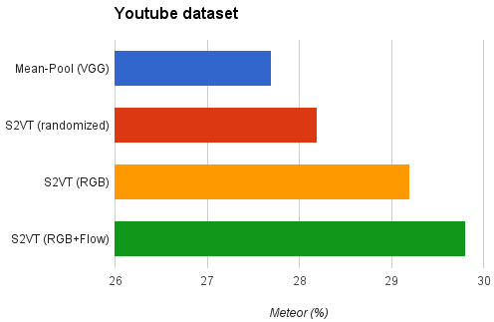
Results (Youtube)
Mean-Pool (VGG)
27.7
S2VT (randomized)
28.2
S2VT (RGB)
29.2
S2VT (RGB+Flow)
29.8

Slide 22
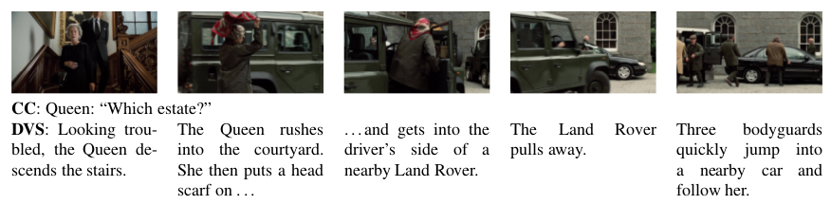
Movie Corpus - DVS

Slide 23
Evaluation: Movie Corpora
MPII-MD
MPII, Germany
94 movies
68,000 clips
Avg. length: 3.9s per clip
~1 sentence per clip
68,375 sentences
M-VAD
Univ. of Montreal
92 movies
46,009 clips
Avg. length: 6.2s per clip
1-2 sentences per clip
56,634 sentences

Slide 24
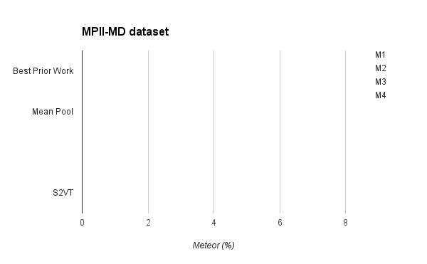
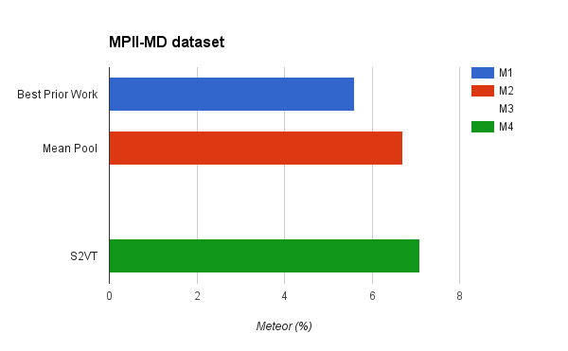
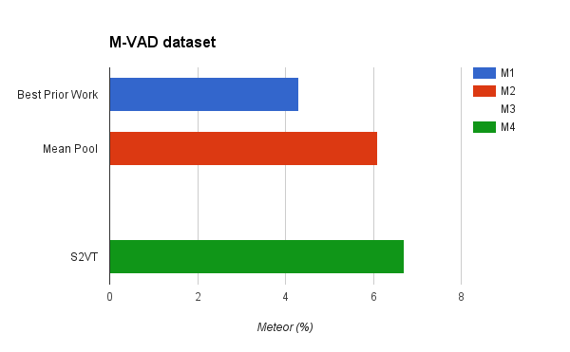
Results (M-VAD Movie Corpus)
MPII-MD Corpus
M-VAD Corpus
Best Prior Work
[Rohrbach et al.
CVPR’15]
5.6
Best Prior Work
[Yao et al. ICCV’15]
4.3
Mean-Pool
6.7
Mean-Pool
6.1
S2VT (RGB)
7.1
S2VT (RGB)
6.7

Slide 25
Can external linguistic knowledge improve descriptive quality?
Integrating distributional word embeddings and LSTM language models trained on external text.
[Venugopalan et. al. EMNLP’16]
Notes:
A major drawback of our previous approach is that

Slide 26
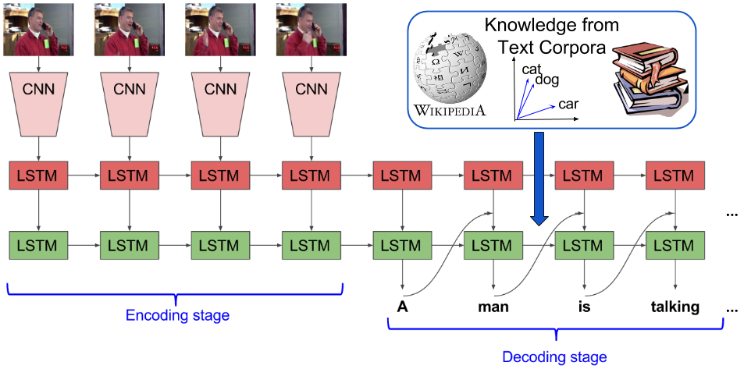
Improving LSTM-based Video Description with Linguistic Knowledge Mined from Text

Slide 27
Integrating Linguistic Knowledge
Distributional Embeddings
Replace one-hot encoding with GloVe
Fusing LSTM language model trained on text
Deep fusion
Combine hidden states of the Language LSTM and Video LSTM when predicting the output.
Combined
GloVe + Deep Fusion

Slide 28
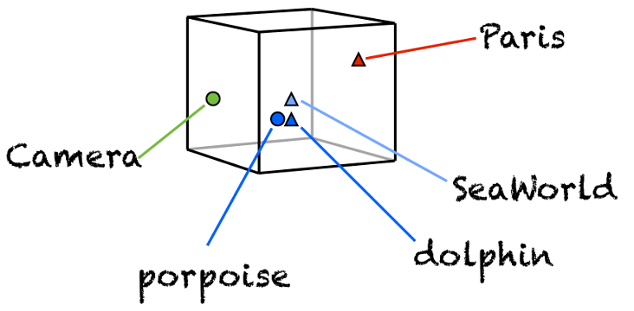
Distributional Embedding
“You shall know a word by the company it keeps” (J. R. Firth, 1957)
Vector representation of
words based on co-occurrence.
semantically similar words are closer.
We use GloVe
lower dimensional dense representation.

Slide 29

Language Model (LM)
A language model learns how likely it is for a sequence of m words to occur together in text.
It assigns a probability to every possible sentence.
A man is talking on a phone.
A man is conversing on a phone.
A man is tapping on a phone.
A man is sitting on a phone.
A man is flying on a phone.
higher
probability

Slide 30
LSTM Language Model
We learn a language model using LSTMs.
Learns to predict next word given a previous words in the sequence.
<BOS>
A
man
is
talking
LSTM
LSTM
LSTM
LSTM
LSTM
A
man
is
talking
<EOS>

Slide 31
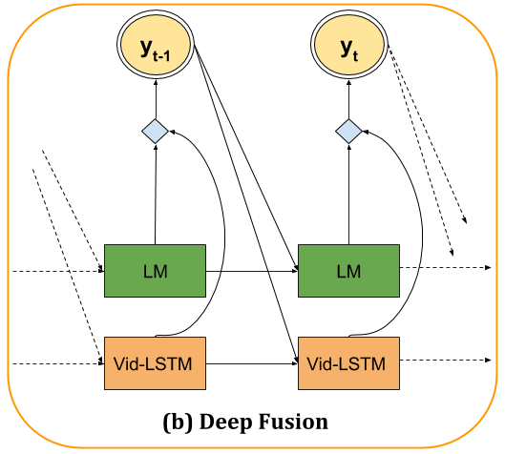
Fusion of LM with Caption Network
Concatenate hidden states of LM LSTM and video caption LSTM.
Fix LM, but train video caption model from scratch.
Related MT work by Gulcehre et. al. (arXiv ‘15)
Softmax
Concatenate

Slide 32
Language Model Data
Single layer LSTM.
Trained to predict the next word.
Data:
Web Corpus: Wikipedia, UkWac, BNC, Gigaword
In Domain: MSCOCO sentences
Vocabulary: 72,700 (most frequent words)
GloVe
Wikipedia + Gigaword

Slide 33
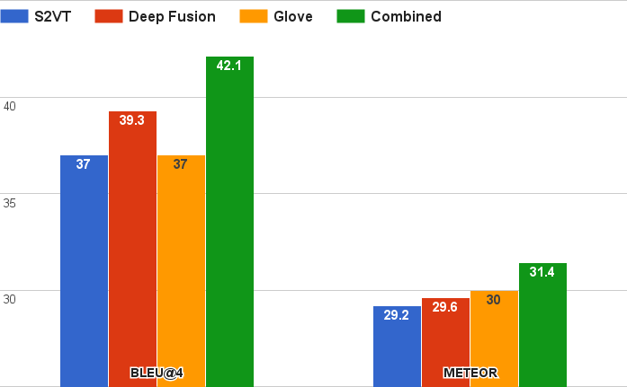
Results (Youtube)

Slide 34
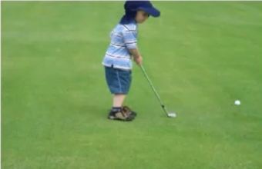
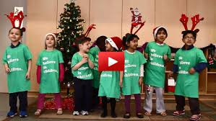
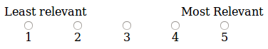
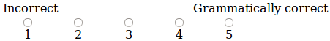
Human Evaluation
Relevance
Grammar
Rate sentences based on how accurately they describe the event depicted in the video.
Rate the grammatical correctness of the following sentences.

Slide 35
Results (Youtube) - Human Evaluation
Model | Relevance | Grammar
S2VT | 2.06 | 3.76
Combined | 2.24* | 4.20*
Human | 4.52 | 4.47

Slide 36
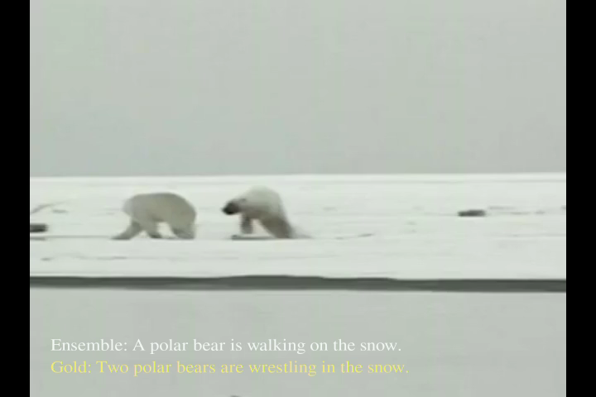
YouTube Cherries

Slide 37
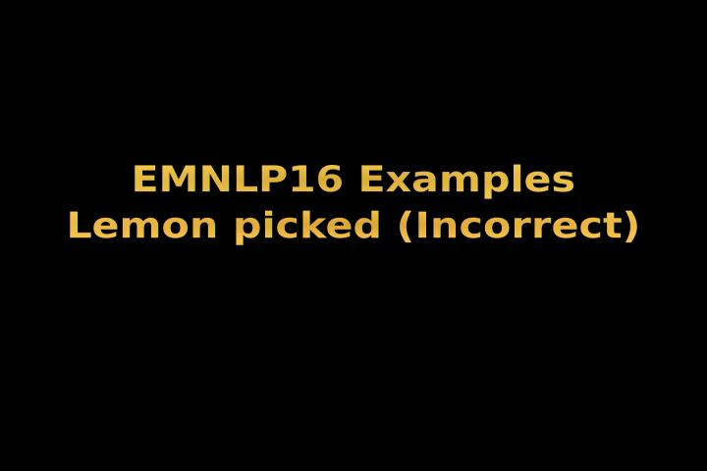
YouTube Lemons

Slide 38

YouTube Sweet Lemons

Slide 39
Results - Movie Corpus (MPII-MD)
Model | METEOR | Grammar
S2VT | 6.5 | 2.6
Glove | 6.7 | 3.9*
Combined | 6.8 | 4.1*

Slide 40
Results - Movie Corpus (M-VAD)
Model | METEOR | Grammar
S2VT | 6.6 | 2.2
Glove | 6.7 | 3.1*
Combined | 6.7 | 3.3*

Slide 41
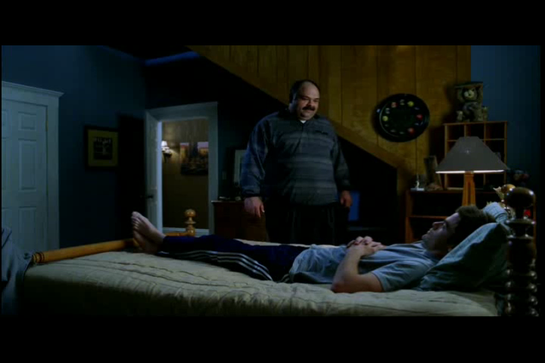
Movie Clip Cherries

Slide 42

Movie Clip Lemons

Slide 43
Conclusions
Grounding language in vision is a fundamental problem with many applications.
We have developed preliminary broad-scale video description systems using LSTMs.
Future Directions:
Segment longer videos into individual activities
Generate animated graphics videos from natural language descriptions

